Slide 1
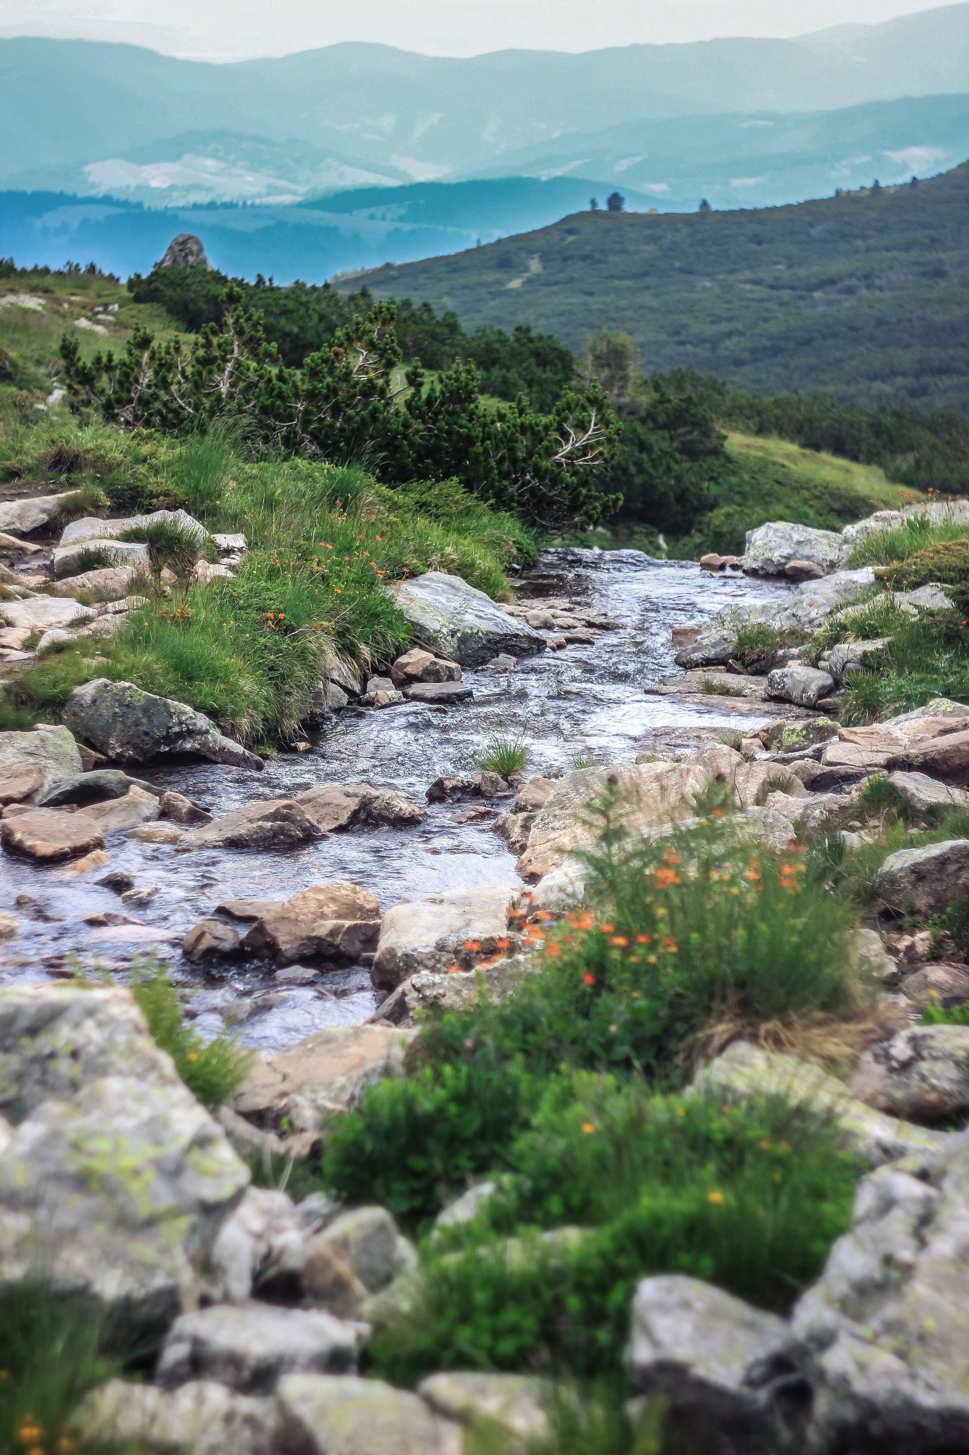
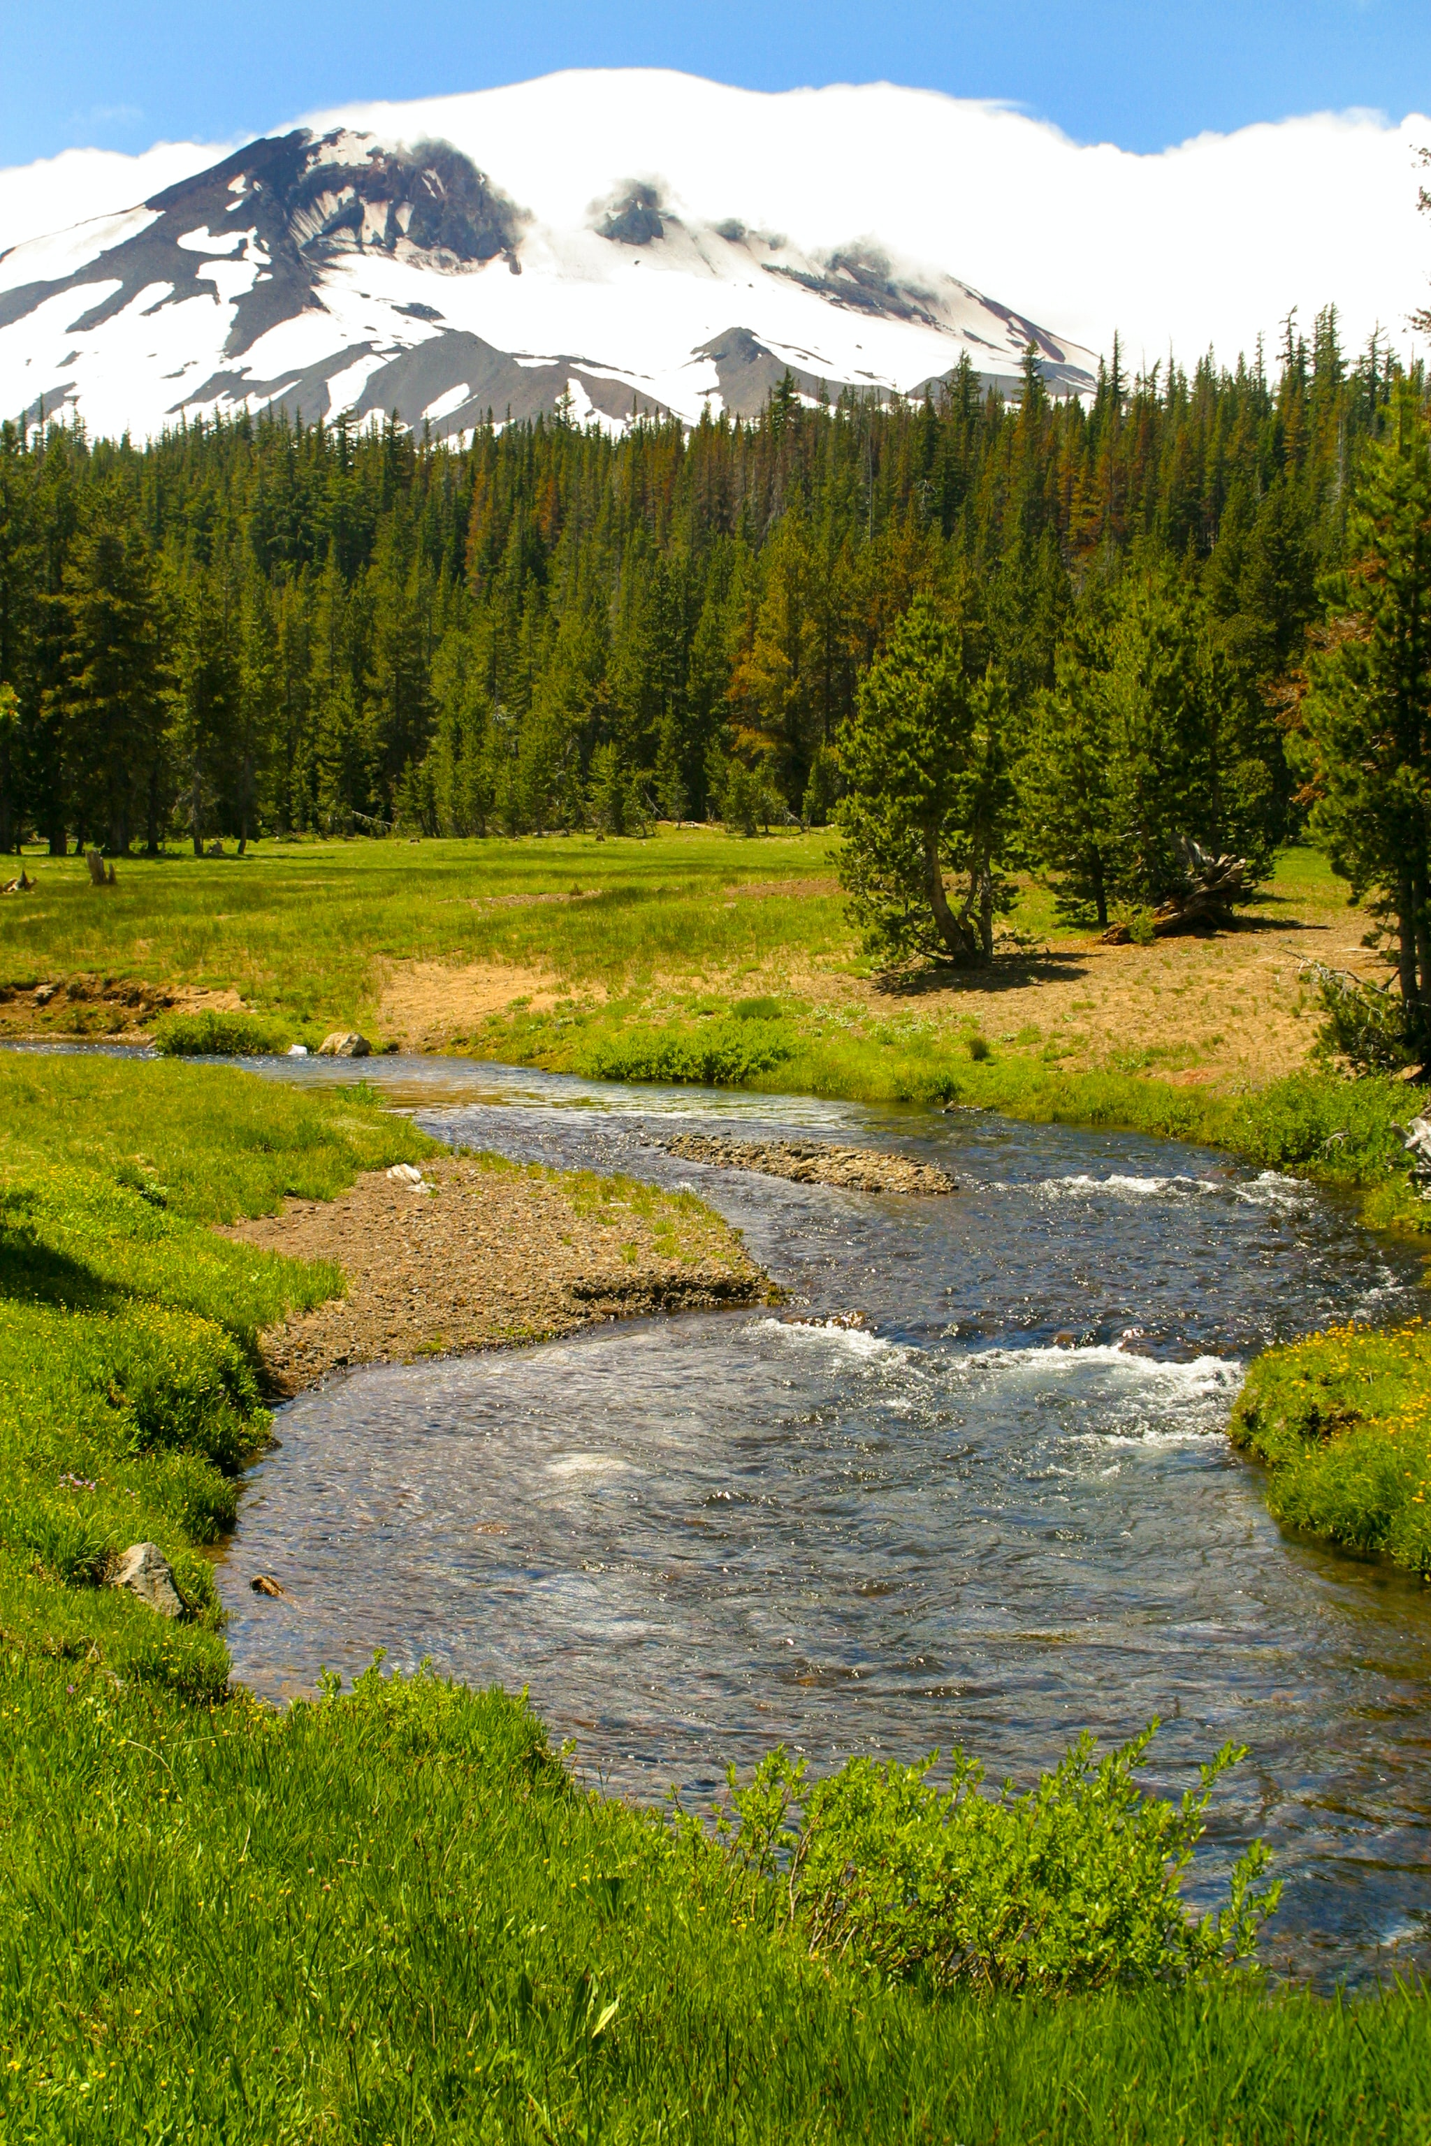





Eco-Hydrology Engineering Design Tool: ClearWater Capabilities – General Constituents, Nutrients, and Contaminants
Todd Steissberg, PhD, PE
Environmental Laboratory, Engineer Research and Development Center (ERDC), U.S. Army Corps of Engineers
Billy E. Johnson, PhD, PE, D.WRE, F.ASCE
LimnoTech
Zhonglong Zhang, PhD, PE, PH
Portland State University
EGU General Assembly 2023
Vienna, Austria
24–28 Apr 2023
Hydrologic
Engineering
Center
https://doi.org/10.5194/egusphere-egu23-12470

Slide 2
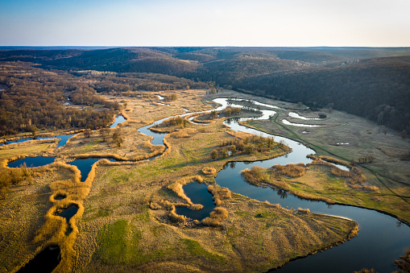
Introduction
Weather is not the only cause of flooding, stream erosion, and pollution. These problems usually occur due to human impacts on watersheds, including urban development, construction activities, hydrologic modifications, forestry, mining, and agricultural practices.
To help evaluate the impact of these serious economic and environmental issues, experts in watershed, riverine, and reservoir engineering at the Engineer Research and Development Center (ERDC), U.S. Army Corps of Engineers (USACE), developed a suite of water quality, contaminant, and vegetation modules that can be integrated with existing hydraulic and hydrologic models.
ClearWater (Corps Library for Environmental Analysis and Restoration of Watersheds) is a library of environmental simulation software that leverages capabilities of existing water resource simulation models to assess environmental impacts and design solutions to manage and restore aquatic ecosystems.
Source: https://unsplash.com/

Slide 3
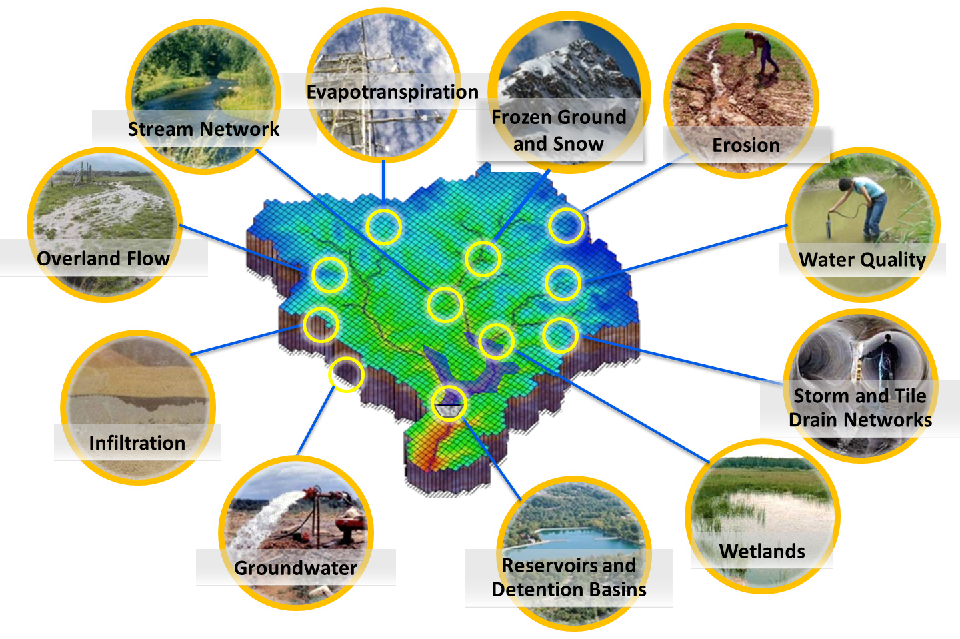
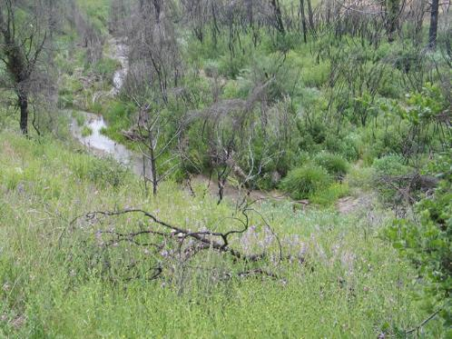
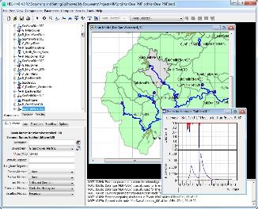
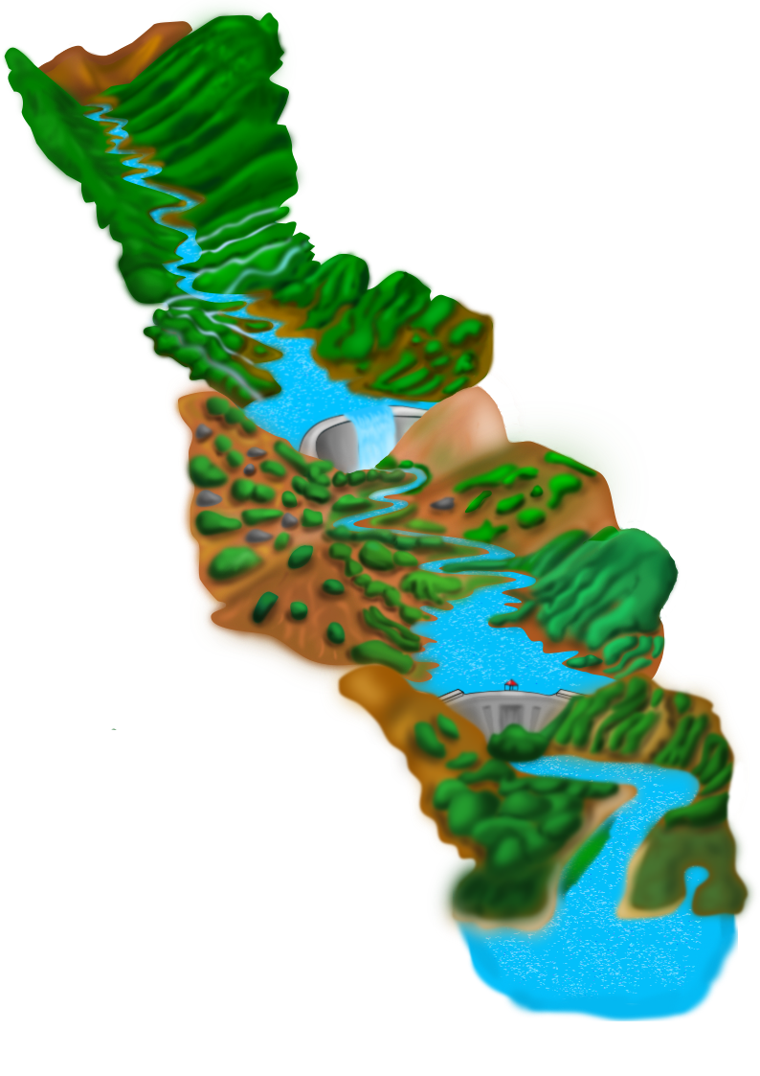
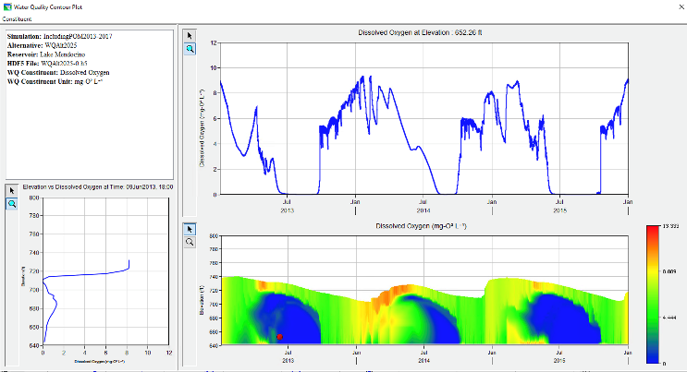
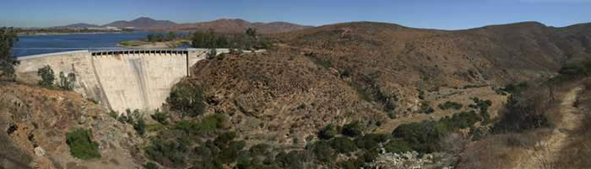
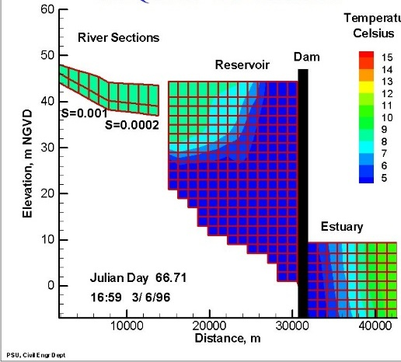
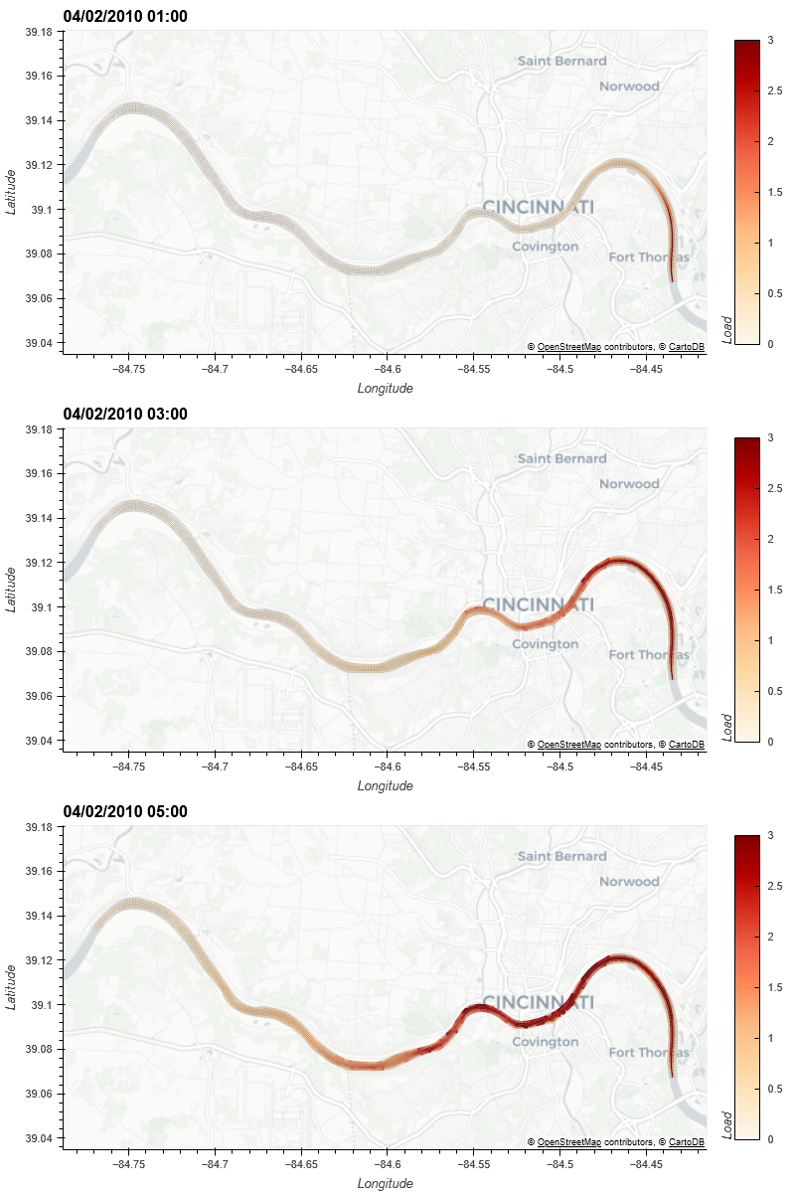
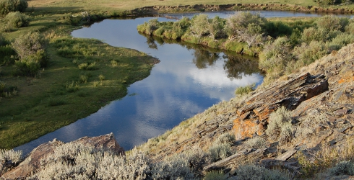
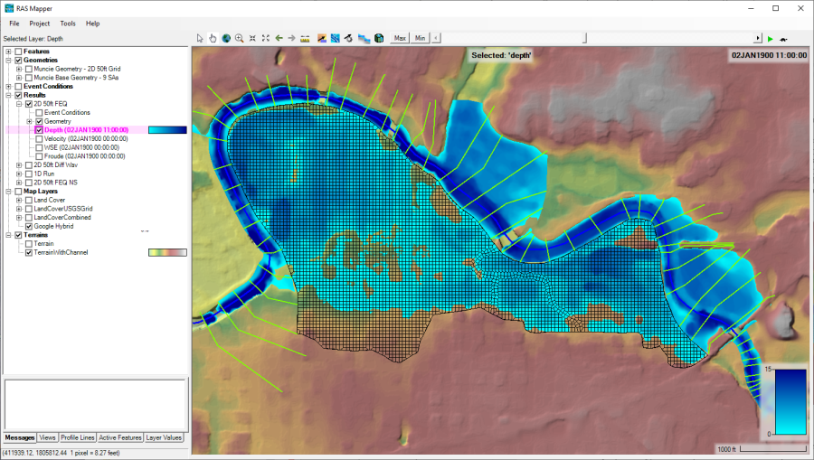
Water Quality and Environmental Systems Modeling
Temperature
Nutrients
Dissolved Oxygen
Algae
Metals
Contaminants
Riparian Vegetation
The Corps Library for Environmental Analysis and Restoration of Watersheds (ClearWater) provides environmental simulation capabilities that leverage existing hydrologic and hydraulic (H&H) models.
Watershed Runoff:
GSSHA: Surface and sub-surface water quality modeling and Nature-Based Features design tool
HEC-HMS: Surface runoff temperature modeling
Reservoirs:
CE-QUAL-W2: 2D reservoir-river hydrodynamics and water quality modeling
HEC-ResSim: Reservoir operations and water quality modeling
Rivers and Floodplains:
HEC-RAS: 1D River hydraulics and water quality & vegetation modeling
ClearWater-Riverine: 2D River-floodplain hydraulics and water quality modeling with HEC-RAS
Estuary
Schematic: Lauren Melendez, ERDC

Slide 4
HEC-RAS-2D: Hydrodynamic Simulations
HEC-RAS can perform two-dimensional (2D) hydrodynamic routing within the unsteady flow analysis portion of the program.
2D flow areas in HEC-RAS can be used in several ways. The following are examples of how 2D flow areas can be used to support modeling with HEC-RAS:
Detailed 2D channel modeling
Detailed 2D channel and floodplain modeling
Multiple 2D flow areas in the same geometry
Directly connect multiple 2D flow areas with hydraulic structures
Mixed flow regime. The 2D capability (as well as the 1D) can handle supercritical and subcritical flow, as well as the flow transitions from subcritical to super critical and super critical to subcritical (hydraulic jumps).
2D flow modeling is accomplished by adding 2D flow area elements into the HEC-RAS model in the same manner as adding a storage area.
A 2D flow area is added by following these steps:
Drawing a 2D flow area polygon
Developing the 2D computational mesh
Linking the 2D flow areas to 1D model elements and/or directly connecting boundary conditions to the 2D areas.

Slide 5
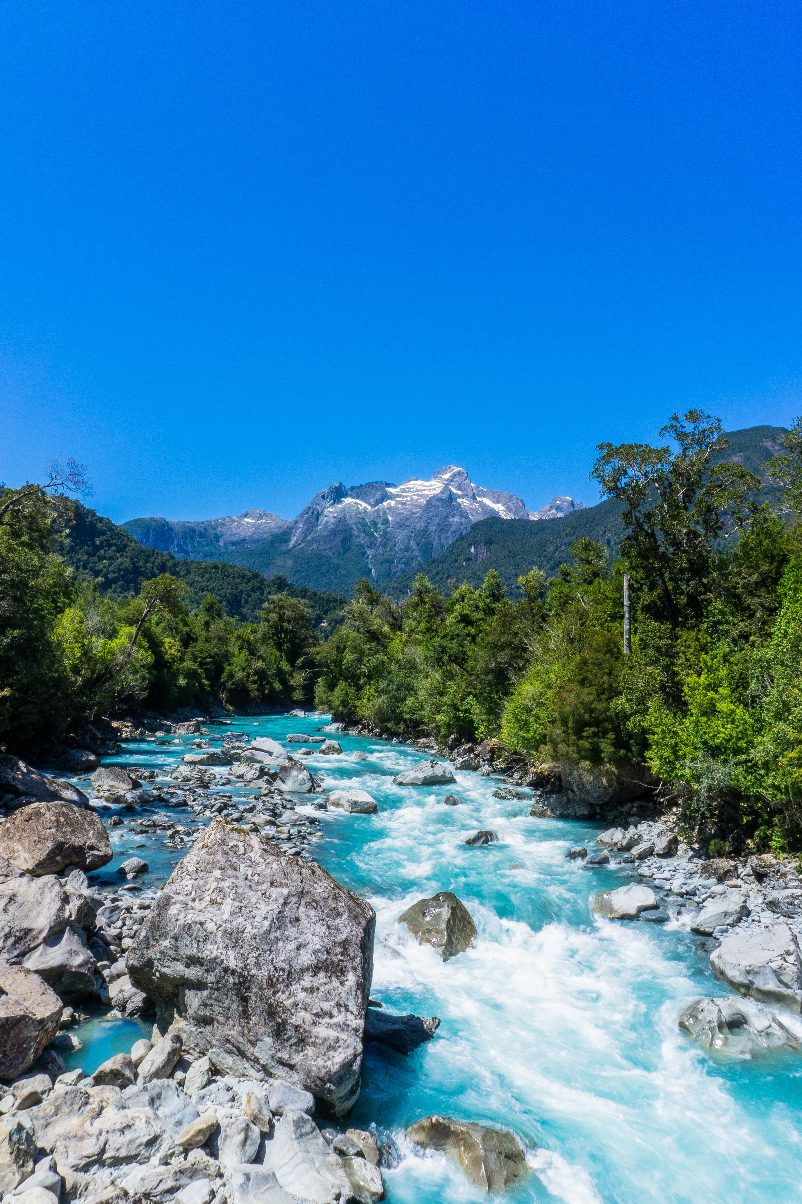
ClearWater-Riverine
The ERDC Environmental Laboratory (ERDC-EL) is developing a state-of-the-art water quality modeling system, Clearwater-Riverine, that simulates temperature and advanced nutrient cycling in branching river systems and floodplains, incorporating hydrodynamic, water quality, and meteorologic inputs from multiple data sources and models.
ClearWater-Riverine will enable the evaluation of system vulnerabilities and identification of adaptation pathways to improve the resilience of floodplain ecosystems to environmental stresses, which include increasing frequency and intensity of extreme precipitation events and decreasing freshwater flows.
Water quality kinetics, heat budget, and transport simulation capabilities in ClearWater-Riverine are furnished by ERDC's ClearWater modules.
The ClearWater-Riverine framework links the capabilities provided by the ClearWater modules and advection-diffusion engine with the two-dimensional (2D) HEC-RAS model.
HEC-RAS models have been developed for most of the watersheds around the world. By leveraging these existing models, ClearWater-Riverine provides a cost-effective, data-driven tool for impact assessment, planning studies, and the restoration and management of aquatic ecosystems.
Source: https://unsplash.com/

Slide 6
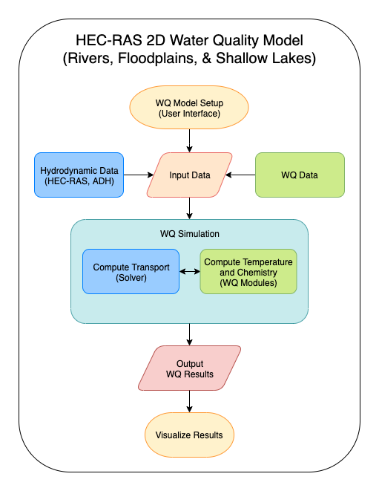
ClearWater-Riverine: 2D Water Quality Modeling with HEC-RAS
Inputs
HEC-RAS-2D Model Data
Volumetric flows, velocities, depths
Model grid (bathymetry)
Observed meteorology and water quality time series
ClearWater water quality modules
Compute heat budget and constituent kinetics for each cell
Water Quality Engine
Computes advection-diffusion across the model grid at each time step
Outputs
Time series of 2D water quality grids, one time series per variable
Time series of simulated hydrodynamic and water quality data at user-selected locations
Framework
Controls model input and output
Controls the computational, input, and output time steps
Controls simulation across the model grid
Coordinates engine, modules, and data

Slide 7
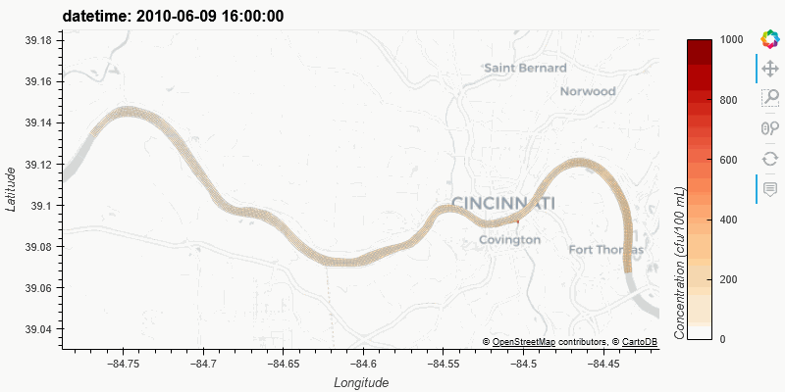
ClearWater-Riverine: E. Coli Transport in the Ohio River

Slide 8
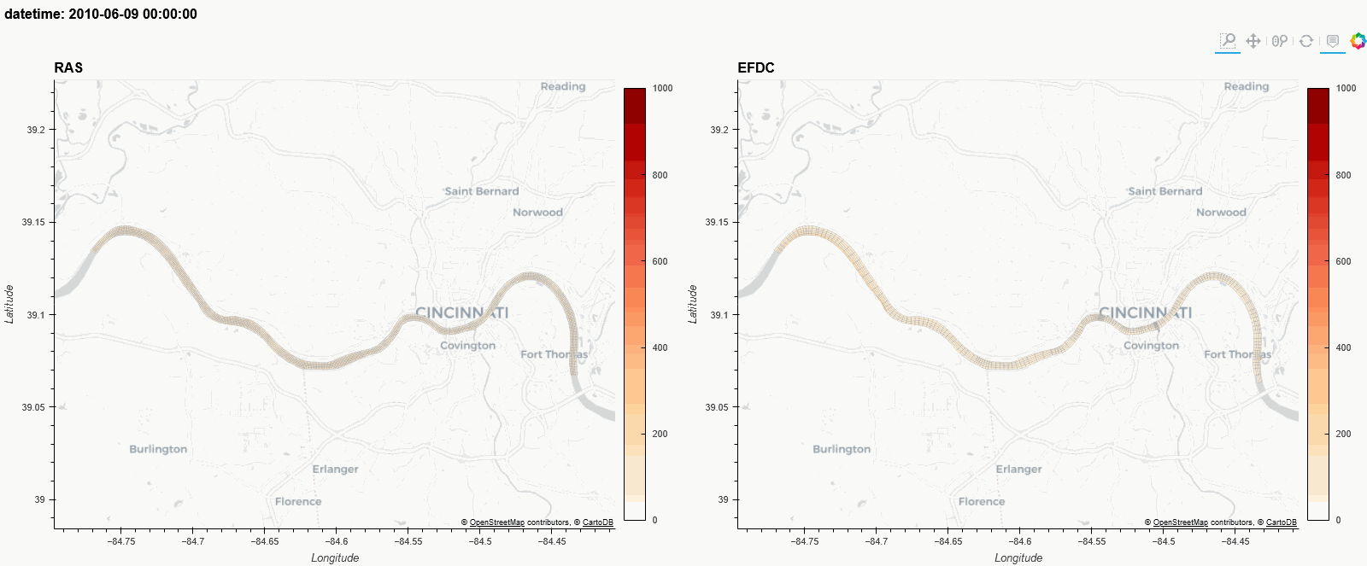
ClearWater-Riverine: Comparison of ClearWater-Riverine (left) with the EFDC model (right)

Slide 9
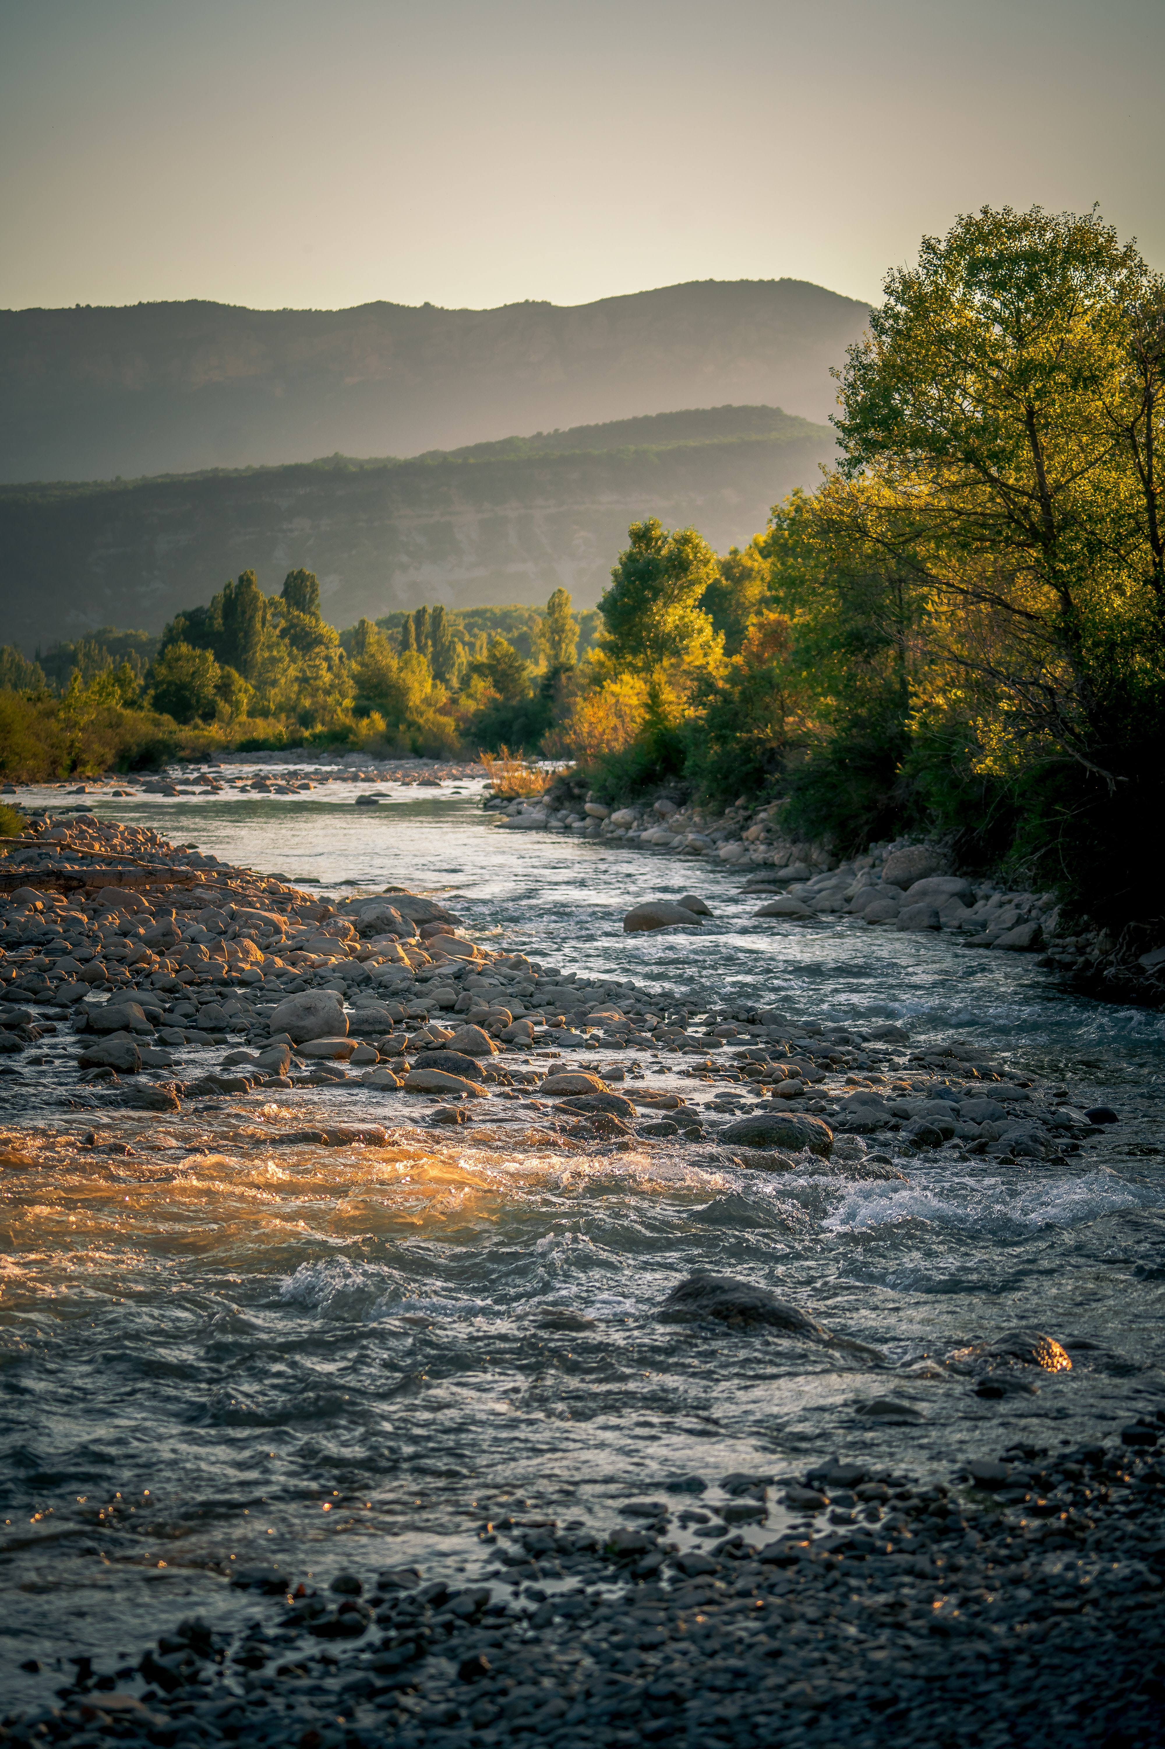
Summary
ClearWater is developed using the Python language, leveraging the xarray, pandas, holoviews, numpy, h5py, and other libraries in the Python ecosystem. It is deployed using a Jupyter notebook with holoviews-based widgets, plots, and animations.
Benefits:
HEC-RAS models provide detailed river hydraulics data and maps (flow, velocity, and water levels). It is widely deployed (100,000 downloads per year), with calibrated hydraulic models already applied to almost all rivers and streams in the United States and many of the rivers around the world.
HEC-RAS is often applied on ecosystem restoration projects to determine the timing and magnitude of water levels and velocities.
ClearWater-Riverine’s water quality simulation capabilities can enhance these projects, helping to understand the effects of the flow of nutrients, heat, and contaminants through aquatic ecosystem.
ClearWater-Riverine leverages the capabilities and wide deployment of HEC-RAS to build water quality models for complex river systems.
ClearWater-Riverine provides the foundation for an Ecohydrology Engineering Design Tool for Nature-Based Features (NBF) design.
Source: https://unsplash.com/

Slide 10
Water Quality Development Team Members and Contributors (Alphabetical)
Anthony Aufdenkampe, LimnoTech
Aaron Byrd, ERDC-CHL
Haley Canham, USACE - Sacramento
John DeGeorge, RMA
Tim Dekker, LimnoTech
Mitch Delcau, Colorado State University
Chuck Downer, ERDC-CHL
Samantha Eanes, USACE - Sacramento
Christine Hoffmann, USACE – Sacramento
Peter Klaver, LimnoTech
Joan Klipsch, HEC
John Kucharski, ERDC-EL
Zach Jelenek, USACE – Sacramento
Mark Jensen, HEC
Billy Johnson, LimnoTech
Sarah Jordan, LimnoTech
Nancy Lam, USACE - Sacramento District
Shannon Larson, RMA
Cindy Lowney, RMA
Lauren Melendez, ERDC-EL
Ryan Miles, RMA
Isaac Mudge, USACE – New Orleans / ERDC
Jennifer Olszewski, ERDC-EL
Leila Ostadrahimi, HEC
Greg Peterson, LimnoTech
Steve Piper, HEC/RMA
Nawa Pradhan, ERDC-CHL
Patrick Ray, University of Cincinnati
Daniel Rucinski, LimnoTech
Jason Rutyna, LimnoTech
Terra Salamida, USACE - Sacramento
Alex Sanchez, HEC
Rahat Saiful, University of Cincinnati
Jonathan Sorunke, USACE - Sacramento
Tad Slawecki, LimnoTech
John Sourbeer, USACE – Pittsburgh
Todd Steissberg, ERDC-EL
Craig Taylor, LimnoTech
Jordan Thennis, USACE - Sacramento
Brian Zettle, USACE – USACE - TNTCX
Kelsey Walak, USACE - Sacramento
Zhonglong Zhang, Portland State University

Slide 11
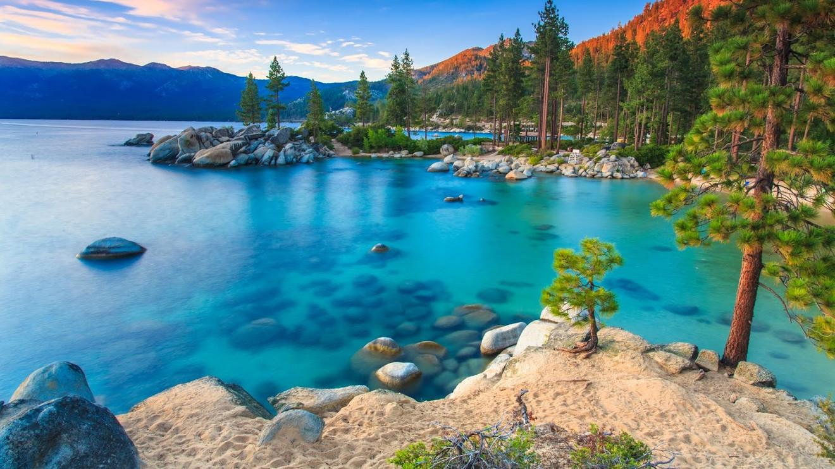
Questions?

